Slide 1
Recessions

Slide 2
What is a recession?
Two consecutive quarters of negative real GDP growth
  A recession is a significant decline in economic activity spread across the economy, lasting more than a few months, normally visible in real GDP, real income, employment, industrial production, and wholesale-retail sales. A recession begins just after the economy reaches a peak of activity and ends as the economy reaches its trough. Between trough and peak, the economy is in an expansion. Expansion is the normal state of the economy; most recessions are brief, and they have been rare in recent decades. – NBER
Time between recessions has typically been 3 to 10 years (post Nixon) and each recession has ranged from 8 to 18 months
It has been 10 years without a recession so odds are increasing every day that one will occur

Slide 3
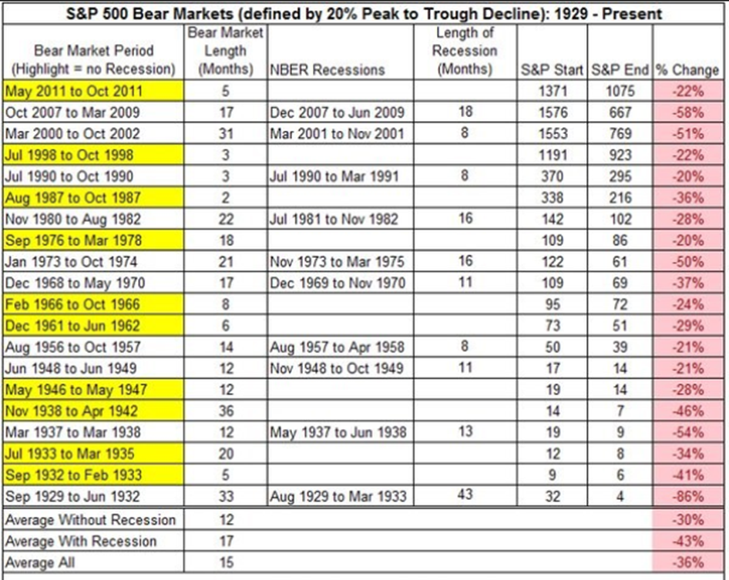
How do you predict a recession?
You don’t
Roubini called the 2008 recession
  Lots of predictions at the end of the economic system
Since the US came off the gold standard in 1971, there have been five recessions
  The stock market has predicted an additional six (based on 20% down – chart goes to 2011 and there were 20% down in July 2014 – Feb 2016)

Slide 4
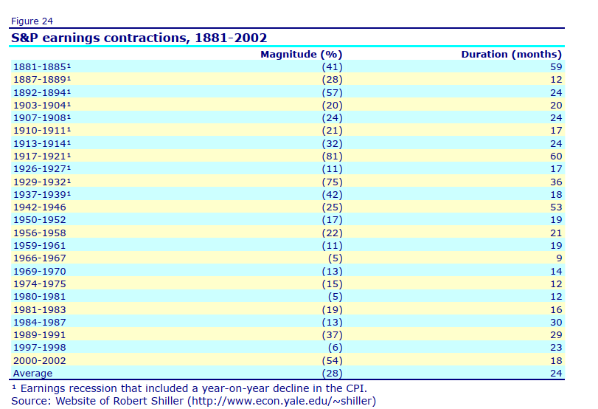
Impact of a recession
Panic – lots of stories of how we will never recover
  Broad based earnings declined
  In general, 95% of all stocks go down
The next theme will likely be that there is too much debt in the system and central banks cannot print enough money to print us out of the mess

Slide 5
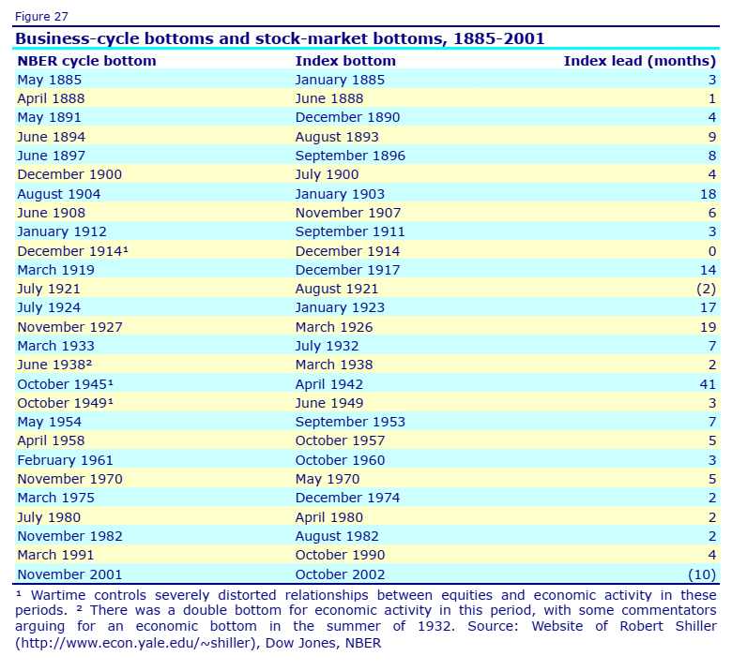
How do you know when a recession is over?
Stock market generally signals end of recession

Slide 6
What types of recessions are there?
Overheating Economy
  Economy grows faster than the potential of the economy which leads to inflation and the monetary authority tightens
Boom and Bust
  Over exuberance in one sector which then needs to right size (tech bubble or S&L crisis)
Balance Sheet / Liquidity
  Occurs when banks experience losses and need to create liquidity by recalling loans or selling assets which drive asset prices lower
Post War
  Usually get a recession after a war

Slide 7
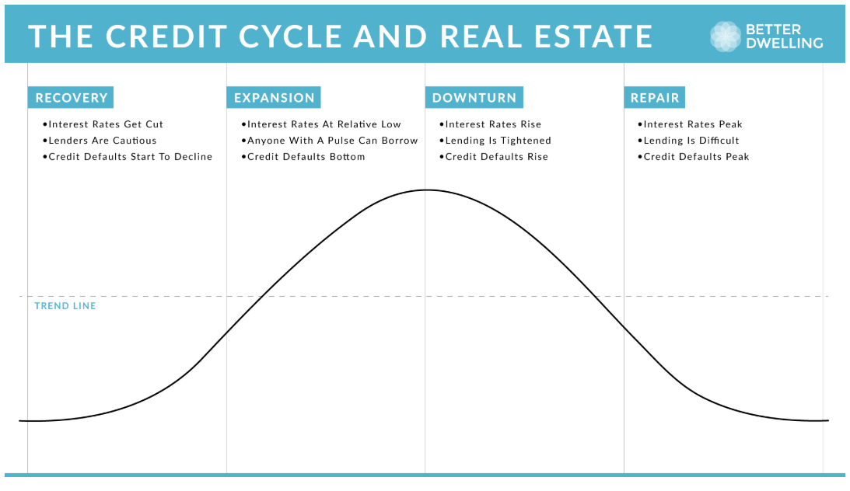
Why are we discussing recessions?
To understand how market participants react to recessions
In general, banks and market participants pull back from providing capital due to uncertainty about the future and losses
  Drives capital out of markets thereby reducing asset prices

Slide 8
Why are we discussing recessions?
The size of the move is dependent upon the type of recession as they have different effects on different constituents
Real world asset prices trend down due to reduced demand driven by uncertainty; reduced future expectations; inability to access leverage
 | Banks | Credit Markets | Stock Market | Real Estate Phys Mkts
Overheating | Mild to Strong | Mild to Strong | Mild to Strong | Mild to Strong
Boom and Bust | Mild except for eye of the storm | Mild except for eye of the storm | Strong to Severe | Mild except for eye of the storm
Liquidity | Severe | Severe | Severe | Severe
Post War | Mild | Mild | Mild to Strong | Mild

Slide 9
How to capitalize of recessions?
As can be seen from Apollo’s private equity returns, having liquidity and buying at the bottom leads to outsized returns
  When times are good, to be a good investor, one has to have edge to beat the market
  In a recession, prices are cheap so you can buy A assets for C pricing – load up!
The most important thing is to have liquidity – cash to buy
Finding the courage to buy is very difficult
  How do you know the bottom has been reached?
Don’t focus on the bottom, focus on starting to buy when stocks are down 20% and keep averaging in
  Don’t aim for the bottom, aim for a lot of assets at a big discount
When averaging in, do not use leverage
  Apply leverage when the market has turned – can create more money to invest by levering on the way up

